Slide 1
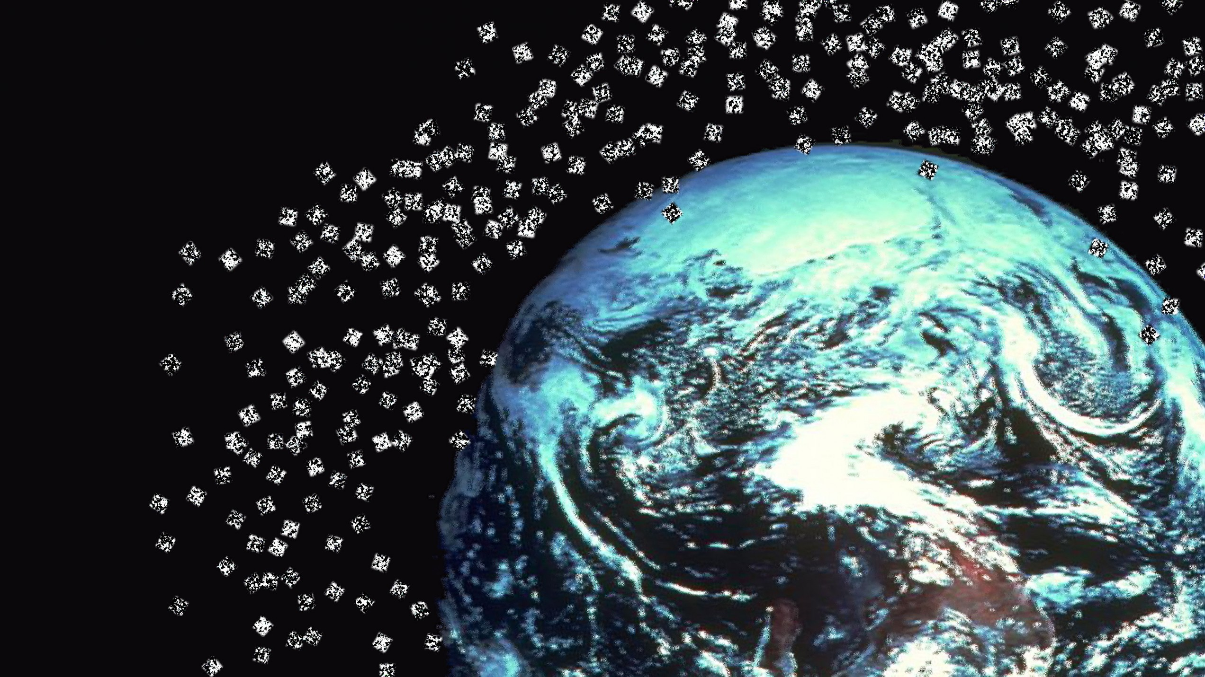
Space Debris

Slide 2
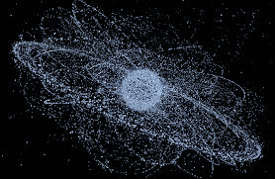
What is Space Debris ?
Space Debris
Natural (Meteoroids)
Usually orbit about the sun
Artificial
(Man-made) Usually in orbit about the Earth
Space debris are:
artificial material that is orbiting Earth but is no longer functional.
can be as large as a discarded rocket stage or as small as a microscopic chip of paint.
LEO (Low Earth Orbit) is an orbital space junk yard
Includes nonfunctional spacecraft, abandoned launch vehicle stages, mission-related debris and fragmentation debris.
Notes:
Space debris encompasses both natural (meteoroid) and artificial (man-made) particles. Meteoroids are in orbit about the sun, while most artificial debris is in orbit about the Earth. Hence, the latter is more commonly referred to as orbital debris. Orbital debris is any man-made object in orbit about the Earth which no longer serves a useful function. Such debris includes nonfunctional spacecraft, abandoned launch vehicle stages, mission-related debris and fragmentation debris.

Slide 3
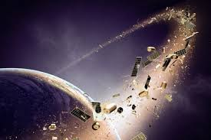
Current status of Space Debris
More than 23,000 orbital debris larger than 10 cm are known to exist. The estimated population of particles between 1 and 10 cm in diameter is approximately 500,000. The number of particles larger than 1 mm exceeds 100 million. As of January 1, 2020, the amount of material orbiting the Earth exceeded 8,000 metric tons.

Slide 4
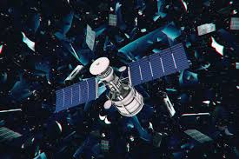
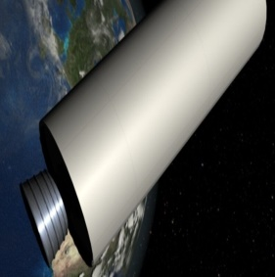
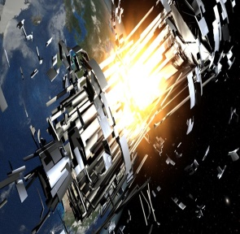
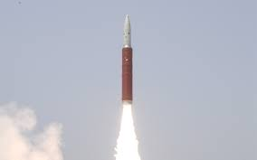
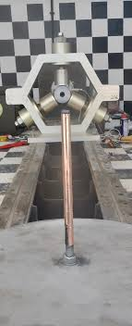
In-­orbit fragmentation
of upper stages gadgets
Causes of Space Debris
Explosions of satellites
and rocket bodies
Anti-satellite test
Rocket-motor firings, which have released Al₂O₃

Slide 5
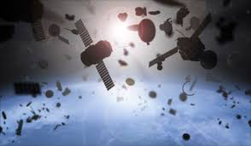
Why is it a growing concern?
Window chipping and minor damage to thermal protection system tiles
Small impacts can produce a cloud of plasma which is an electrical risk to the panels.
Satellites are destroyed by micrometeorites and (small) orbital debris (MMOD)
changing both its orbit and rotation rate.
During STS-115 in 2006 a fragment of circuit board bored a small hole through the radiator panels in Atlantis's cargo bay
On STS-118 in 2007debris blew a bullet-like hole through Endeavour's radiator panel.
Significant impact on the solar panels of Mir, the Soviet space station.
Space Shuttle missions
Spacecraft
The Kessler syndrome is a
theoretical scenario in which
the density of objects in LEO is
high enough that collisions of
objects could cause a cascade
effect where each collision generate
space debris that increases chances of further collisions. Distribution of debris in orbit could render space activities and the use of satellites in specific orbital ranges economically impractical for many generations.
Although most debris burns up in the atmosphere, larger debris objects can reach the ground intact. According to NASA, an average of one cataloged piece of debris has fallen back to Earth each day for the past 50 years. Despite their size, there has been no significant property damage from the debris.
Kessler syndrome
On Earth
Notes:
problems

Slide 6
Tracking systems for Space debris

Slide 7
Ways to prevent it

